Slide 1

NFL Playoff Analysis
TEAM 4

Slide 2

TEAM MEMBERS
Dozie Kingsley
Lenin Perez
Dre Franklin
Mark Lech

Slide 3
In the NFL, can statistics predict Super Bowl winners?
Super Bowl

Slide 4
Development Process
Tested APIs,
web scraping,
and downloads
1
Determined a viable source of data
2
Divided areas of analysis into sections for team members
3
Coded and analyzed,
both separately and via Zoom
4
Assembled final Jupyter
notebook and presentation
5

Slide 5
STRATEGY:
ANSWER 4 QUESTIONS
WITH 20 YEARS OF DATA
1. Are Super Bowl winners statistically superior to the other playoff and non-playoff teams?
2. Are there statistical similarities between Super Bowl winners?
3. Is there a relationship between offense and defense?
4. Do any statistics predict a future Super Bowl winner vs. the other playoff losers?

Slide 6
Tools & Technologies
PRO-FOOTBALL-REFERENCE.COM FOR DATA
EXCEL FOR ALTERNATE CHARTING
JUPYTER NOTEBOOK:
w PANDAS FOR DATA ANALYSIS
w NUMPY FOR MATHEMATICAL FUNCTION
w SCIPY FOR LINEAR REGRESSION ANALYSIS
w STATMODELS.API FOR REGRESSION MODELS
w SEABORN FOR DATA VISUALIZATION

Slide 7
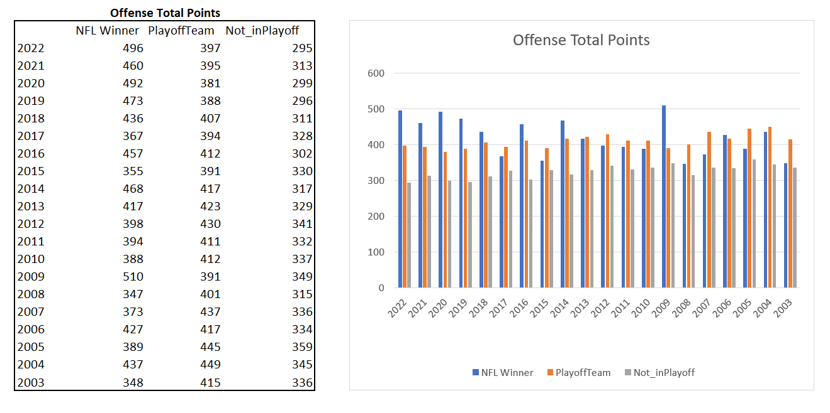
EXCEL ANALYSIS:
Super Bowl Winners vs. All Playoff Teams vs. Non-Playoff Teams
1. Are Super Bowl winners statistically superior to the other playoff and non-playoff teams?
Pivot tables and bar charts used
to analyze 3 types of teams
over 20 years of data:
Statistics of all Super Bowl
winners.
The other playoff teams that did
not win the Super Bowl.
Teams that did not qualify for
the playoffs.

Slide 8
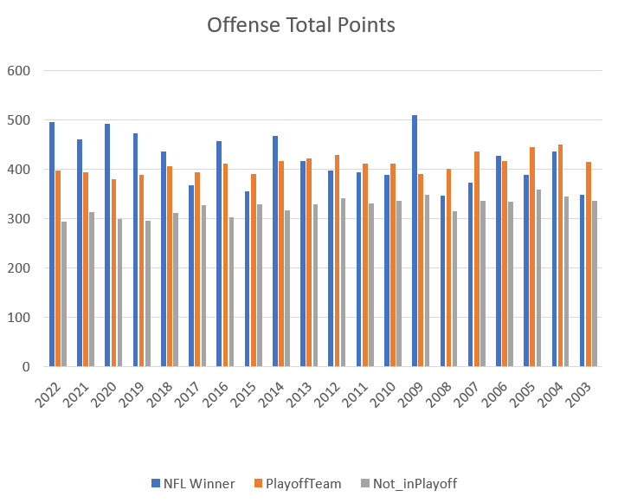
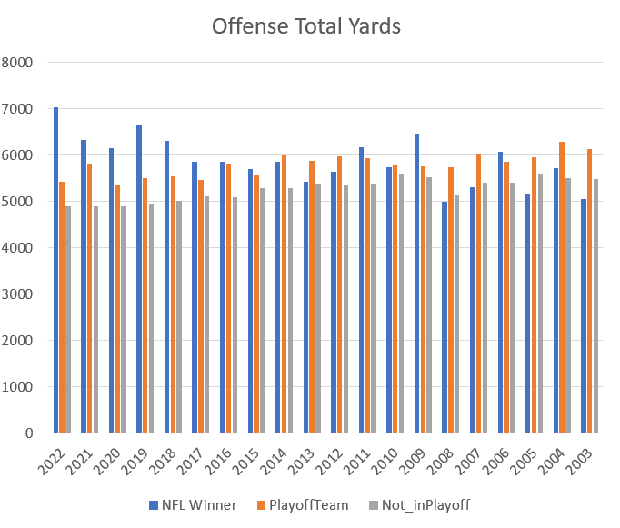
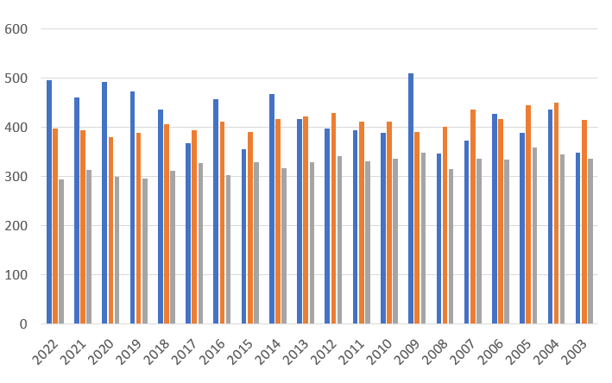
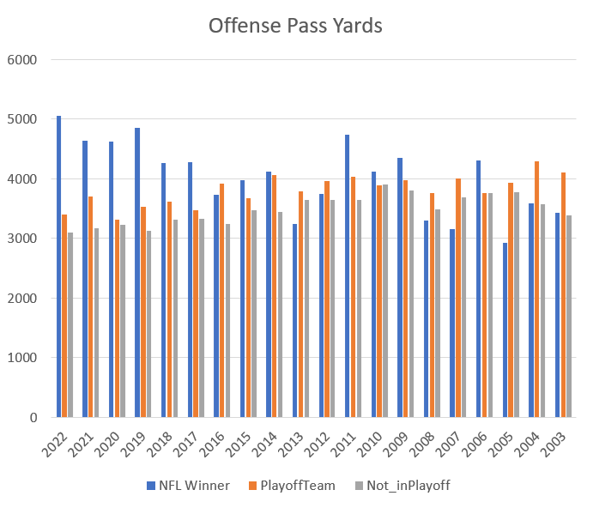
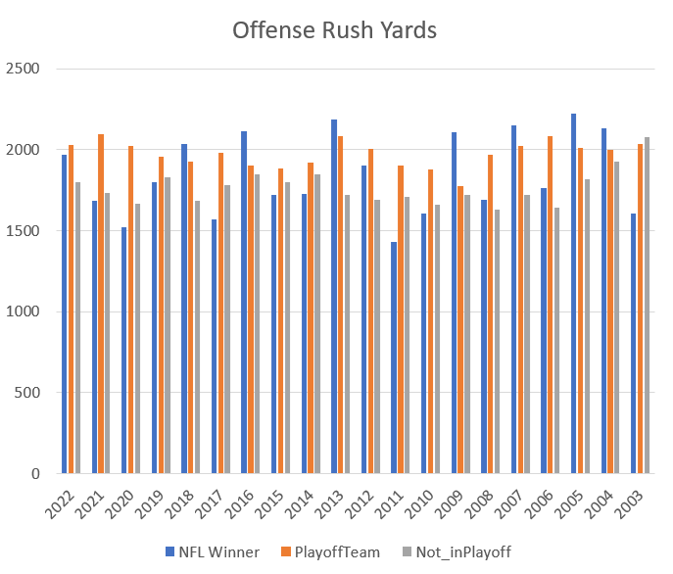
Super Bowl Winners,
Other Playoff Teams, and
Non-Playoff Teams
The 4 most widely-referenced categories of offense were analyzed.
Using the variables and compared with the winner of the Super Bowl, is there a consistent pattern exhibited by the winner team?
Conclusion: The winning team did not outperform the averages of teams in the playoffs (and not in the playoffs) for offense.
However, the winner consistently outperformed the Total Points average of teams not in the playoffs over the period under study.

Slide 9
STRATEGY:
ANSWER 4 QUESTIONS
WITH 20 YEARS OF DATA
No. Analyzing 4 major areas of offense, the winning team did not consistently outperform the averages of the other teams.
1. Are Super Bowl winners statistically superior to the other playoff and non-playoff teams?
2. Are there statistical similarities between Super Bowl winners?
3. Is there a relationship between offense and defense?
4. Do any statistics predict a future Super Bowl winner vs. the other playoff losers?

Slide 10
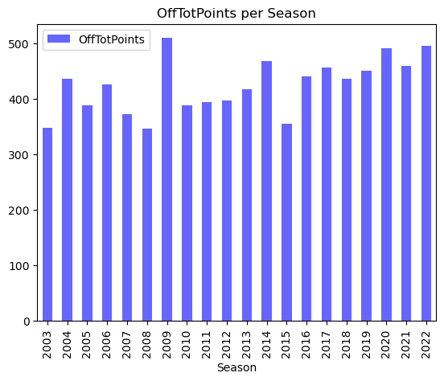
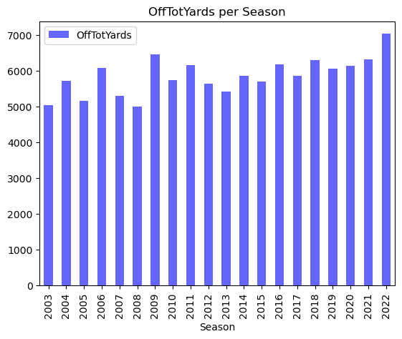
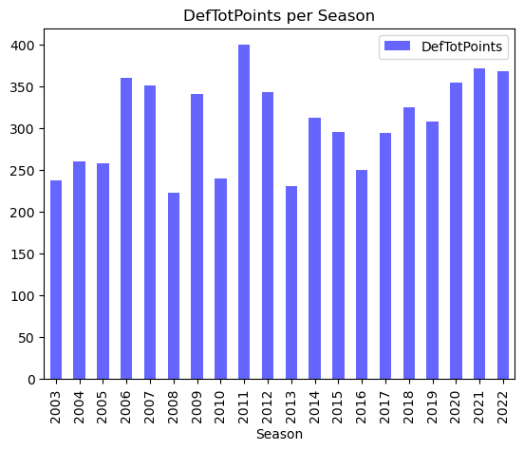
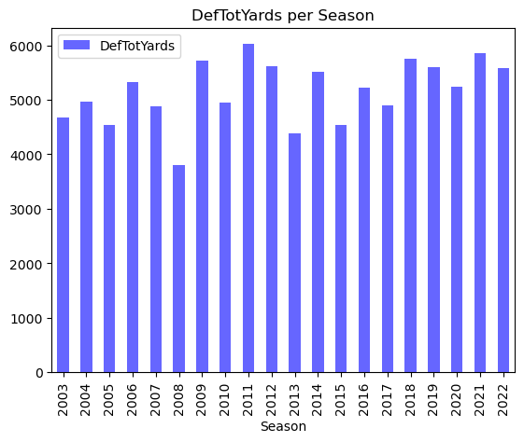
2. Are there statistical similarities
between Super Bowl winners?
Co-efficient of Variation (CV): 11.6% Co-efficient of Variation (CV): 8.8%
BAR PLOTS:
Super Bowl Winners Over 20 Years
50 statistical categories were evaluated in all.
Co-efficient of Variation (CV) is the Standard Deviation divided by the Mean. It measures how spread out the values are.
CV is a percentage, therefore it can be compared across different units of measurement (points scored, yards, etc.).
CV values ranged from 3.5% to 299.7%.
Co-efficient of Variation (CV): 17.9% Co-efficient of Variation (CV): 11.2%

Slide 11
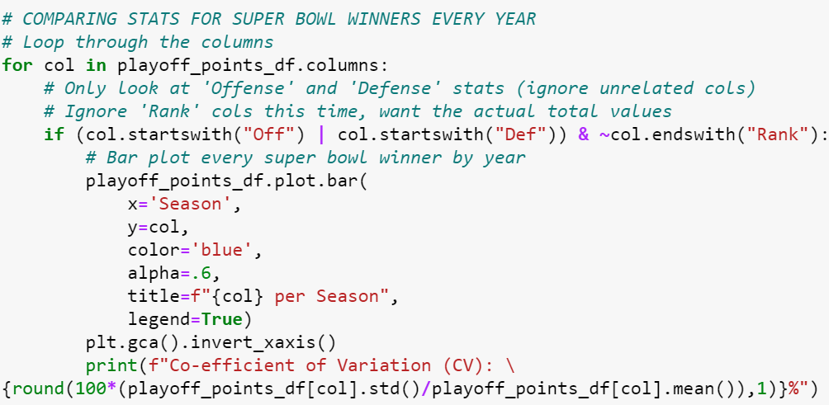
2. Are there statistical similarities
between Super Bowl winners?
Co-efficient of Variation (CV): 11.6% Co-efficient of Variation (CV): 8.8%
BAR PLOTS:
Super Bowl Winners Over 20 Years
Code snippet:
Co-efficient of Variation (CV): 17.9% Co-efficient of Variation (CV): 11.2%

Slide 12
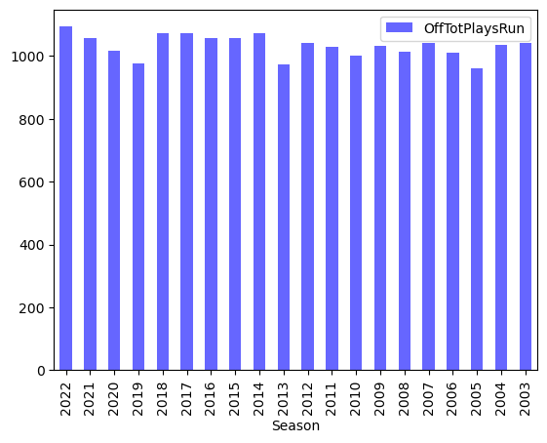
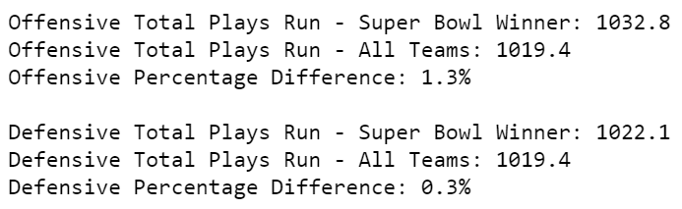
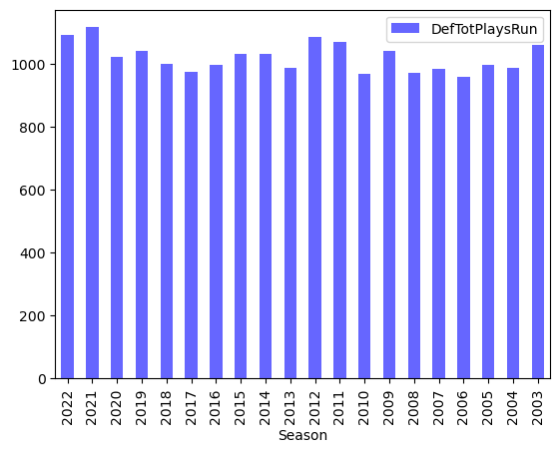
BAR PLOTS:
Super Bowl Winners Over 20 Years
CV: 11.6...OffTotPoints
CV: 8.8...OffTotYards
CV: 3.5...OffTotPlaysRun
CV: 7.8...OffTotYardsPerPlay
CV: 27.1...OffTotTurnovers
CV: 33.6...OffTotFumbles
CV: 9.1...OffTot1stDowns
CV: 14.7...OffPassCompletions
CV: 11.9...OffPassAttempts
CV: 14.8...OffPassYards
CV: 24.2...OffPassTouchdowns
CV: 39.0...OffPassInterceptions
CV: 9.6...OffPassNetYardsPerAttempt
CV: 15.1...OffPass1stDowns
CV: 10.3...OffRushAttempts
CV: 13.5...OffRushYards
CV: 23.4...OffRushTouchdowns
CV: 8.4...OffRushYardsPerAttempt
CV: 13.8...OffRush1stDowns
CV: 16.0...OffNumOfPenalties
CV: 19.6...OffPenaltyYards
CV: 25.8...Off1stDownsByPenalty
CV: 16.0...OffPctOfDrivesEndingInScore
CV: 27.5...OffPctOfDrivesEndingInTurnover
CV: 299.7...OffExpectedPointsContributed
CV: 17.9...DefTotPoints
CV: 11.2...DefTotYards
CV: 4.5...DefTotPlaysRun
CV: 9.3...DefTotYardsPerPlay
CV: 20.3...DefTotTakeaways
CV: 23.1...DefTotFumbles
CV: 9.6...DefTot1stDowns
CV: 12.2...DefPassCompletions
CV: 8.7...DefPassAttempts
CV: 13.9...DefPassYards
CV: 30.7...DefPassTouchdowns
CV: 27.8...DefPassInterceptions
CV: 9.7...DefPassNetYardsPerAttempt
CV: 11.3...DefPass1stDowns
CV: 10.2...DefRushAttempts
CV: 21.3...DefRushYards
CV: 43.5...DefRushTouchdowns
CV: 13.9...DefRushYardsPerAttempt
CV: 21.3...DefRush1stDowns
CV: 11.1...DefNumOfPenalties
CV: 13.0...DefPenaltyYards
CV: 29.9...Def1stDownsByPenalty
CV: 16.3...DefPctOfDrivesEndingInScore
CV: 19.0...DefPctOfDrivesEndingInTurnover
CV: 107.5...DefExpectedPointsContributed
Co-efficient of Variation (CV): 3.5
OffTotPlaysRun
The two lowest CVs (i.e. the lowest disbursements) were “Offensive Total Plays Run” and
“Defensive Total Plays Run”. However, these categories were only 1.3% and 0.3% higher than the league average, so they can be eliminated.
Conclusion: Across 50 statistical categories, we found no meaningful statistical similarities between Super Bowl winners. The statistics that were most similar between all winners were also similar to
league averages, while most statistics varied substantially between winners.
Co-efficient of Variation (CV): 4.5
DefTotPlaysRun

Slide 13
STRATEGY:
ANSWER 4 QUESTIONS
WITH 20 YEARS OF DATA
No. Analyzing 4 major areas of offense, the winning team did not consistently outperform the averages of the other teams.
1. Are Super Bowl winners statistically superior to the other playoff and non-playoff teams?
2. Are there statistical similarities between Super Bowl winners?
No. Across 50 statistical categories, the few that were similar were also very close to the league average, and most other categories varied substantially.
3. Is there a relationship between offense and defense?
4. Do any statistics predict a future Super Bowl winner vs. the other playoff losers?

Slide 14
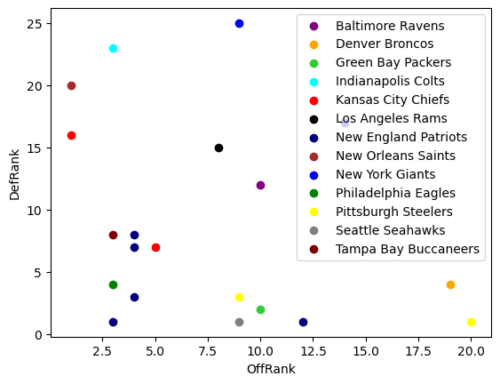
SCATTER PLOT:
Offense and Defense of Super Bowl Winners
3. Is there a relationship between offense and defense?
9 teams that have won the Super Bowl while being ranked
as a Top 5 Offense.
9 teams that have won the Super Bowl while being ranked
as a Top 5 Defense.
Only 3 teams have won the Superbowl while being ranked
as both a Top 5 Offense and Top 5 Defense.
15 teams that have won the Super Bowl while being ranked
as a Top 5 Offense.
13 teams that have won the Super Bowl while being ranked
as a Top 5 Defense.
15 teams have won the Superbowl while being ranked as
both a Top 10 Offense and Top 10 Defense.
Conclusion: Based on the scatter plot , regardless of
Offensive rank, teams with the better defense may have a
slightly higher chance of winning the Super Bowl.

Slide 15
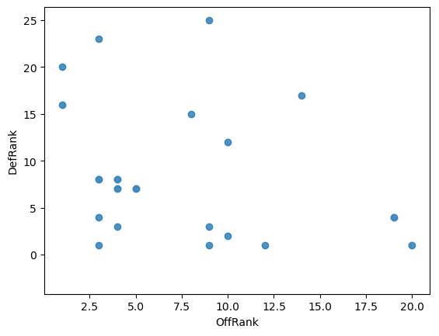
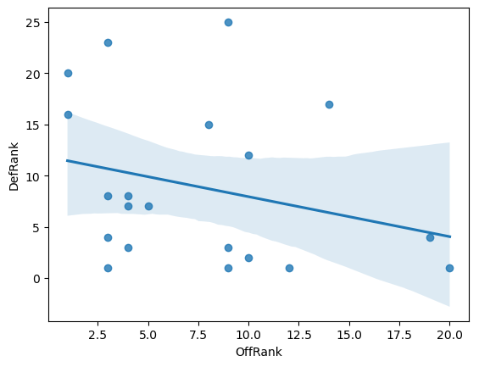
LINEAR REGRESSION:
Offense and Defense of Super Bowl Winners
3. Is there a relationship between offense and defense?
As defense gets better (a higher ranking), the offense has a tendency to get weaker. More research would be required to understand why, but the data is widely spread out and correlation is weak.

Slide 16
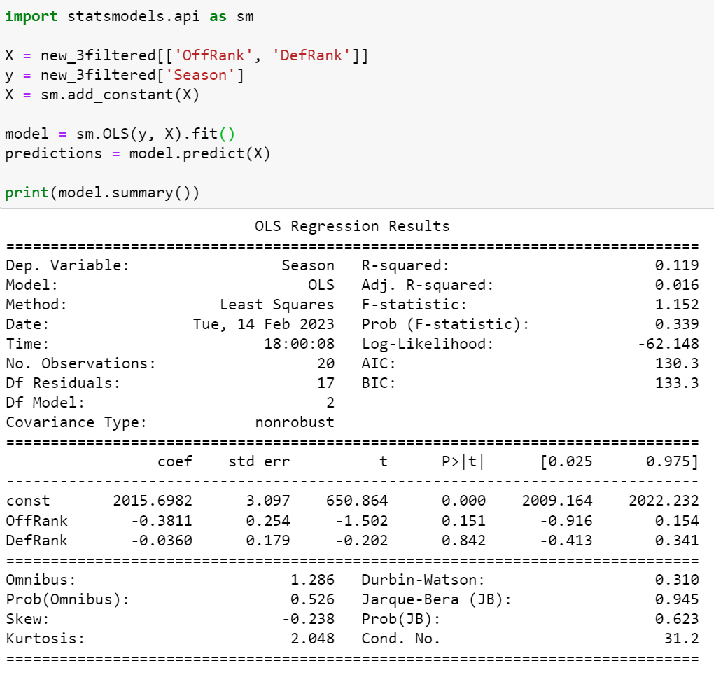
LINEAR REGRESSION
through statsmodels
3. Is there a relationship between offense and defense?
The Dependent Variable is “Season”, with 20 Observations.
R-squared measures how much the offensive and defensive rankings are explained by changes in the season. 0.119 means this Linear Regression model only explains 11.9% of the change throughout the seasons in this model. The R-squared value can increase with additional variables, so this model may look more accurate with multiple variables even if they are poorly contributing.
The Adjusted R-squared adjusts for predictors that are not significant. The low Adjusted R-squared of 0.016 may indicate that some variables are not contributing well to this model’s R-squared value.
Conclusion: A limited sample size of 20 observations makes it difficult to accurately identify offensive and defensive rankings trends.

Slide 17
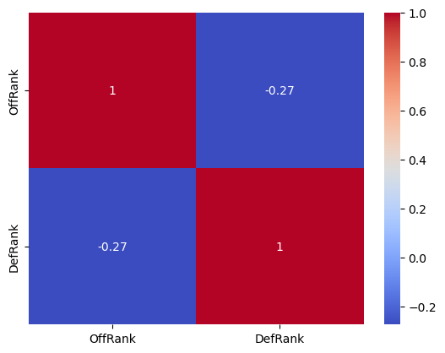
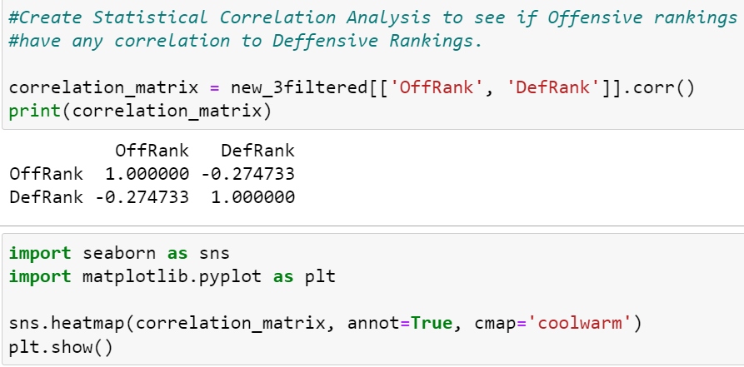
STATISTICAL CORRELATION HEAT MAP
3. Is there a relationship between offense and defense?
The negative number shows a non-correlation to the two fields. Offensive Rankings and Defensive Rankings, when compared to each other, appear to be a Non-Correlation.
Conclusion: Shows a NON correlation between Offensive and Defensive rankings. Rankings are based on offensive and defensive stats, however, those stats can be skewed by a number of factors such as playing time, coaching decisions, etc. Because of these factors, teams can be ranked for a number of reasons and because of those reasons we therefore have an incomplete picture of any actual correlation.

Slide 18
STRATEGY:
ANSWER 4 QUESTIONS
WITH 20 YEARS OF DATA
No. Analyzing 4 major areas of offense, the winning team did not consistently outperform the averages of the other teams.
1. Are Super Bowl winners statistically superior to the other playoff and non-playoff teams?
2. Are there statistical similarities between Super Bowl winners?
No. Across 50 statistical categories, the few that were similar were also very close to the league average, and most other categories varied substantially.
3. Is there a relationship between offense and defense?
No. Comparisons between offensive and defensive rankings yields weak correlations, and analysis indicates the sample size could be larger.
4. Do any statistics predict a future Super Bowl winner vs. the other playoff losers?

Slide 19
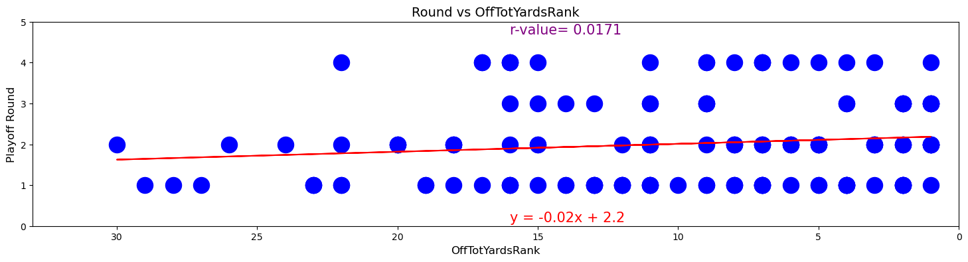
Every playoff team's regular season rank, and the highest round they advanced to
BASIC SCATTER PLOT:
4. Do any statistics predict a future Super Bowl winner vs. the other playoff losers?
50 statistical categories were analyzed (1 example below).
There are 4 playoff rounds (1-4).
Higher rounds mean a team has won more playoff games.
Round 4 is the Super Bowl Winner. The best rankings are to the right
Issue with a basic scatter plot: Overplotting (multiple plots on the same value).

Slide 20
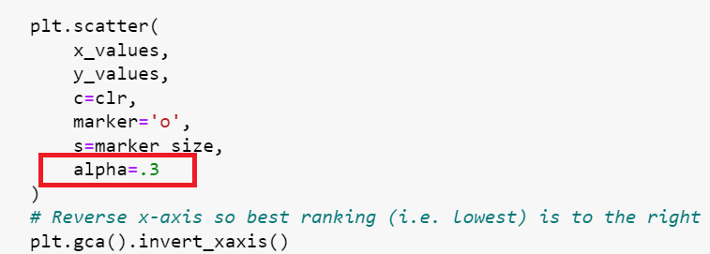
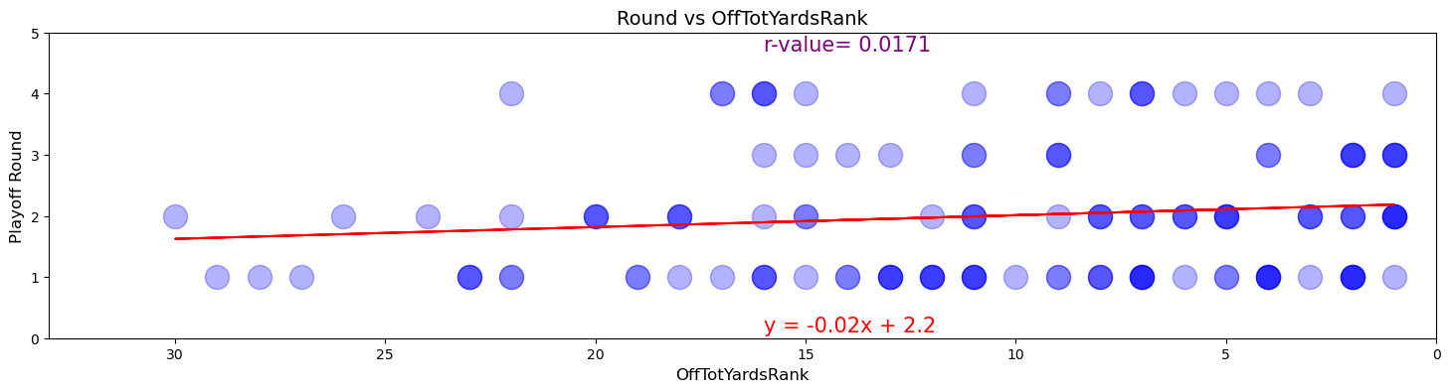
SCATTER PLOT WITH TRANSPARENCY
Every playoff team's regular season rank, and the highest round they advanced to
Issue: Still not clear enough to determine
the true extent of overplotting

Slide 21
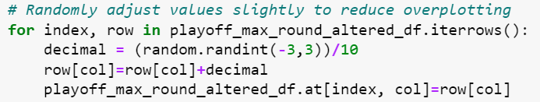
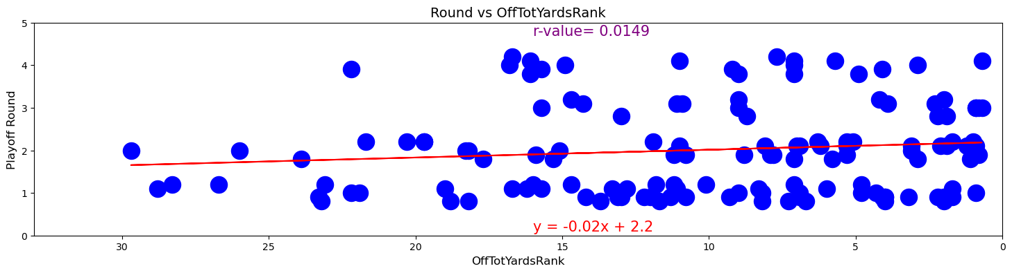
JITTER PLOT
Every playoff team's regular season rank, and the highest round they advanced to
Reduce overplotting by slightly altering
each value randomly from -0.3 to 0.3
Issue: Plot values are close but
no longer completely accurate

Slide 22
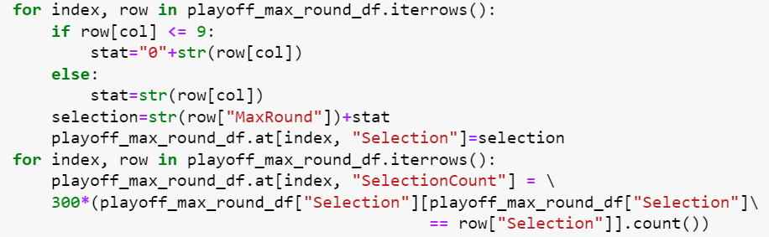
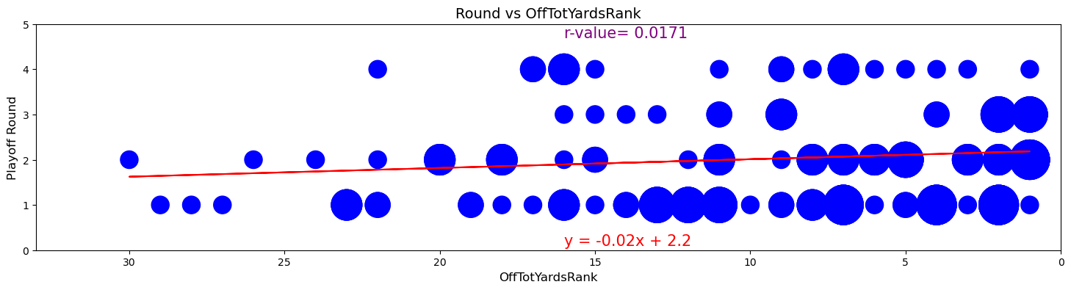
BUBBLE PLOT
Every playoff team's regular season rank, and the highest round they advanced to
Counts identical plot points so that
larger points indicate higher values,
which prevents overplotting issues
while preserving data integrity

Slide 23
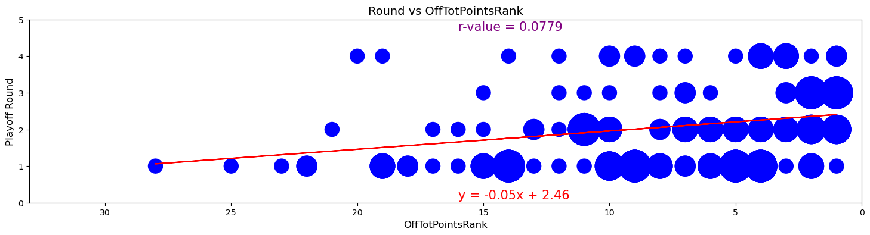
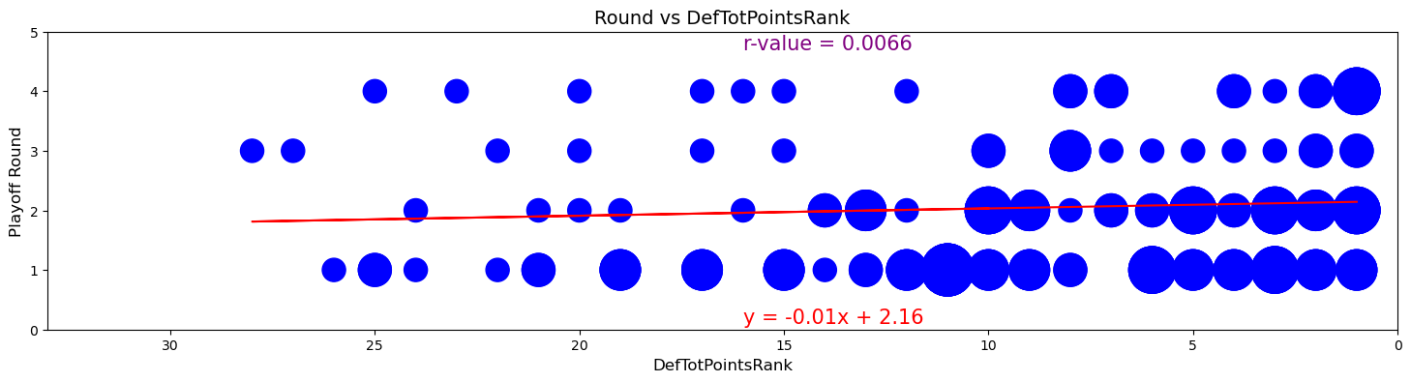
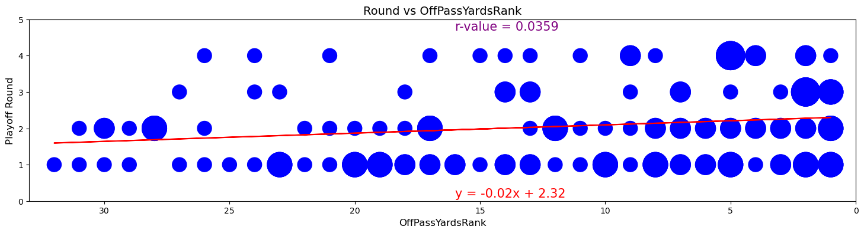
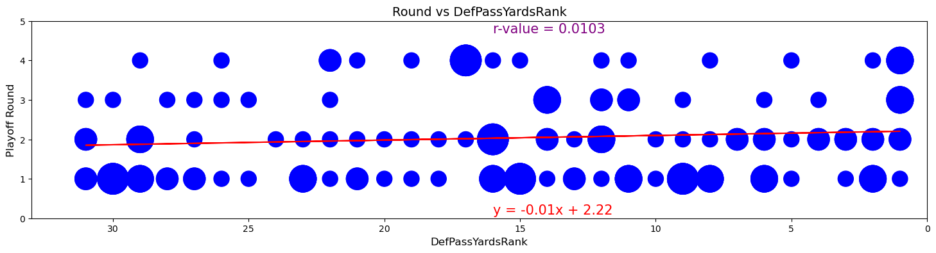
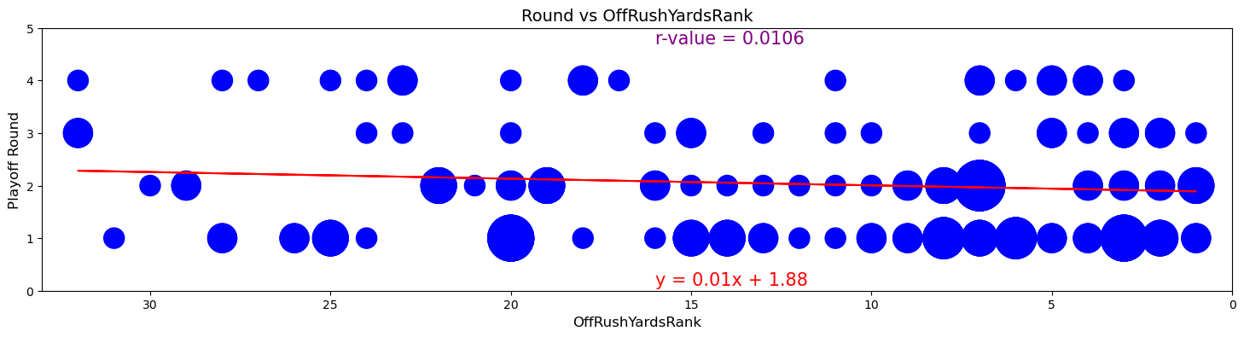
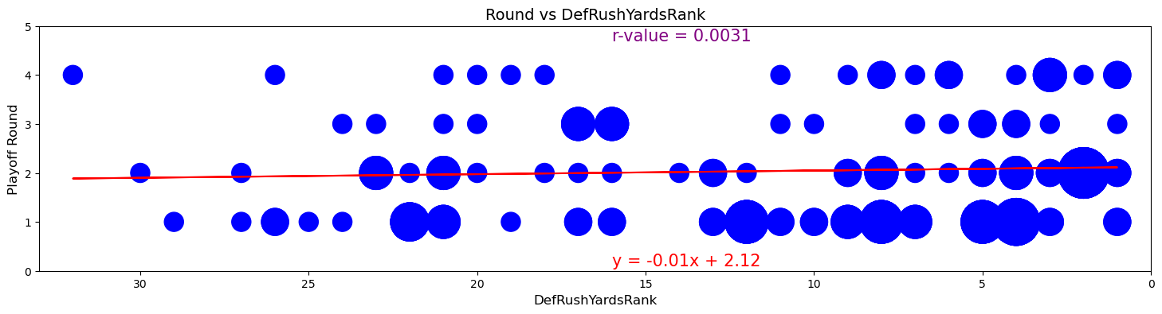
BUBBLE PLOTS
Conclusion: The bubble plots look interesting but don’t correlate to Super Bowl wins.
Offensive Total Points Rank Defensive Total Points Rank
Offensive Passing Yards Rank Defensive Passing Yards Rank
Offensive Rushing Yards Rank Defensive Rushing Yards Rank

Slide 24
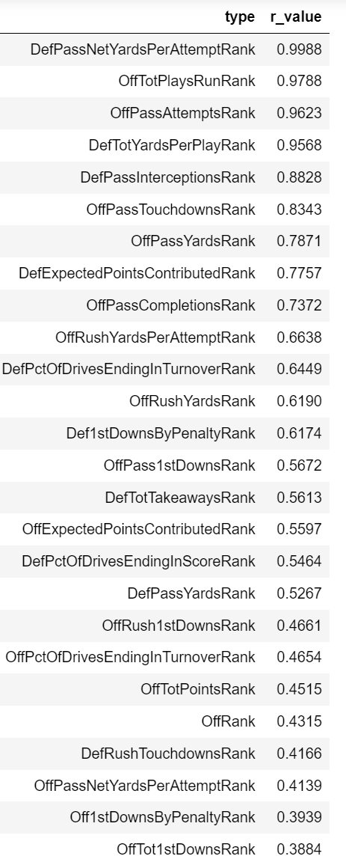
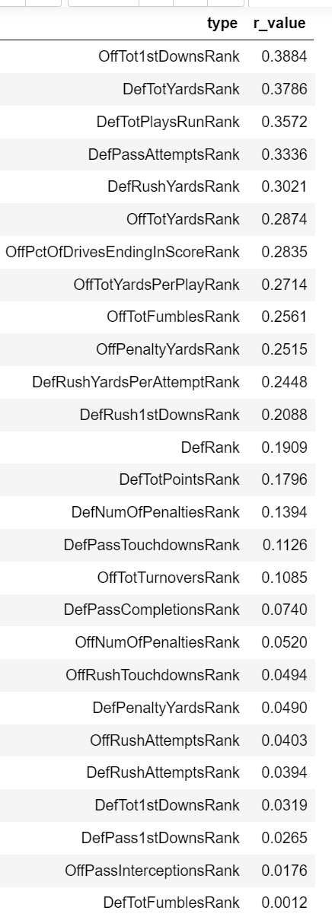
ADDITIONAL
R-VALUE ANALYSIS
Grouped by the Round Number, and
averaging that round’s rankings across all years
Grouping by the round number, and using the average rankings of all years and all teams in each round, the r-values of a few categories produced some very high correlations.

Slide 25
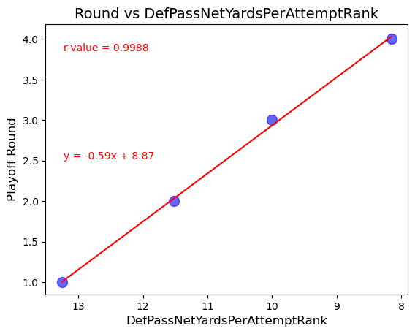
BUBBLE PLOT
The highest correlation is:
Defensive Passing Net Yards Per Attempt
Of the 50 statistical categories, this is one of the most obscure
The r-value is an extremely strong .9988
Average Rank in this category:
8.2 – Round 4 (Super Bowl Winner)
10.0 – Round 3
11.5 – Round 2
13.3 – Round 1

Slide 26
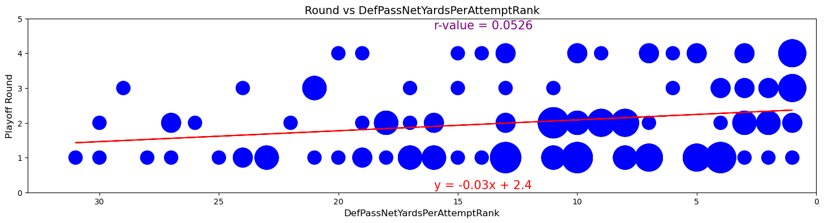
COMPARED TO THE BUBBLE PLOT
Conclusion: The highly correlated plot points to the right are average values of all playoff teams, across all years. Teams with higher rankings in this area tend to go further in the playoffs. When viewed along with the bubble plot below, it becomes more clear that this is likely not an accurate indicator of a Super Bowl win. More analysis is needed to determine how accurate of an identifier this is, possibly predicting which teams have better than average chances of success.

Slide 27
No. Analyzing 4 major areas of offense, the winning team did not consistently outperform the averages of the other teams.
1. Are Super Bowl winners statistically superior to the other playoff and non-playoff teams?
2. Are there statistical similarities between Super Bowl winners?
No. Across 50 statistical categories, the few that were similar were also very close to the league average, and most other categories varied substantially.
3. Is there a relationship between offense and defense?
No. Comparisons between offensive and defensive rankings yields weak correlations, and analysis indicates the sample size could be larger.
4. Do any statistics predict a future Super Bowl winner vs. the other playoff losers?
No. When statistical categories are viewed one-by-one within a season, no strong correlation exists. When all 20 years are taken as averages, some very strong correlations appear, but more analysis is needed to compare with each individual year.
G A M E O V E R

Slide 28
In the NFL, can statistics predict Super Bowl winners?
Conclusion:
No
Super Bowl

Slide 29
T H A N K Y O U !
0:00
TEAM 4
VISITOR
F I N A L S C O R E
100 0
20
15
1 10 38 4
DOWN
TO GO
BALL ON
QTR
01
00
21
04
Team 4

